Slide 1

Statistical Fundamentals:
Using Microsoft Excel for Univariate and Bivariate Analysis
Alfred P. Rovai
Linearity & Scatterplots
PowerPoint Prepared by
Alfred P. Rovai
Microsoft® Excel® Screen Prints Courtesy of Microsoft Corporation.

Slide 2
Linearity
The assumption of linearity is that there is an approximate straight line relationship between two continuous variables. It is a common assumption in many bivariate procedures, such as bivariate correlation and regression analysis, because solutions are based on the general linear model (GLM).
If a relationship is nonlinear, the statistics that assume it is linear will either underestimate the strength of the relationship or fail to detect the existence of a relationship.
Methods of evaluating linearity:
  Draw on theory or prior research.
  Use a scatterplot. (Note: in regression analysis, nonlinearity is usually most evident in a plot of observed versus predicted values.)

Slide 3
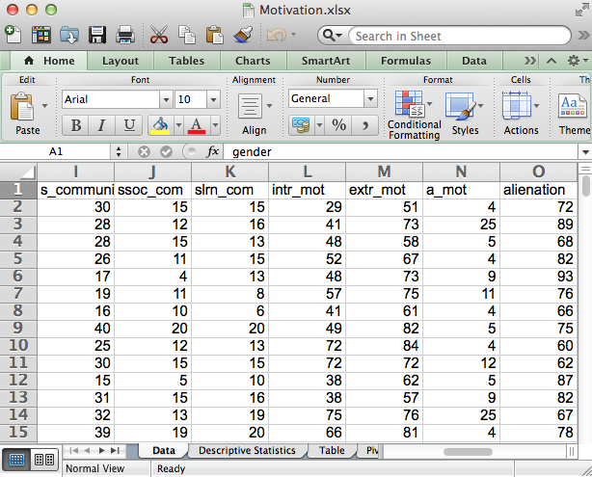
Creating a Scatterplot
Open the dataset Motivation.xlsx.
File available at
http://www.watertreepress.com/stats
TASK
Evaluate linearity for variables
powerlessness and normlessness.

Slide 4
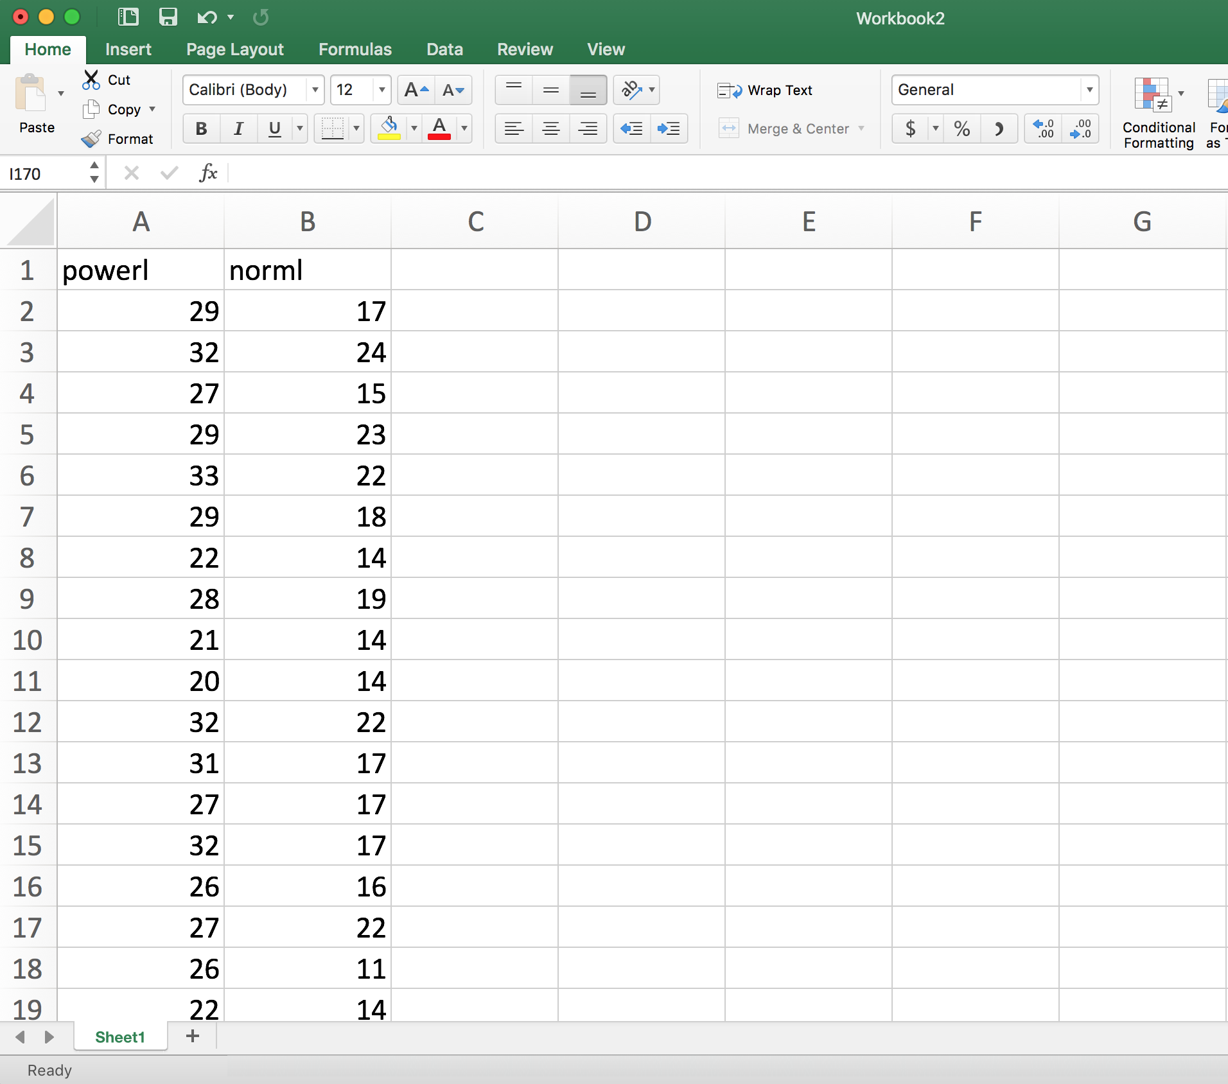
Creating a Scatterplot
Copy variables powerlessness (powerl) and normlessness (norml) from the Data tab to columns A and B in new workbook (or use a new tab in the existing workbook).
Click on cell A2 and hold the Shift key down while clicking on cell B170 to select cells A2:B170.
Click on the Excel Insert menu and follow the Chart > X Y (Scatter) procedure.

Slide 5
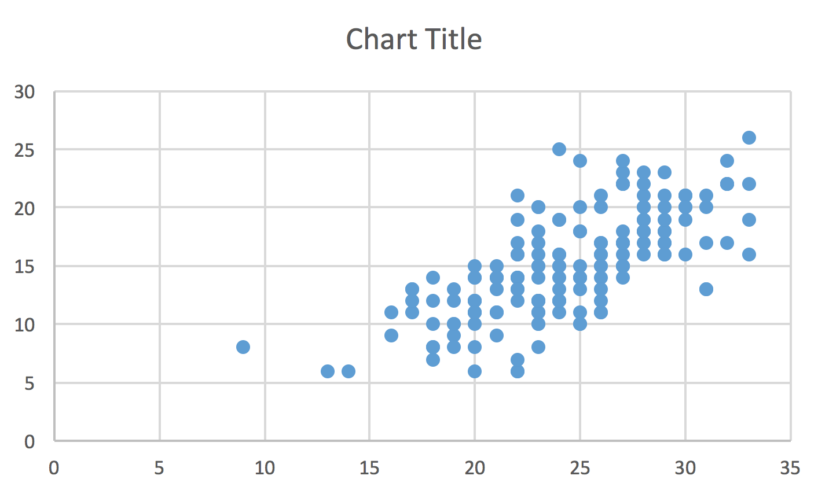
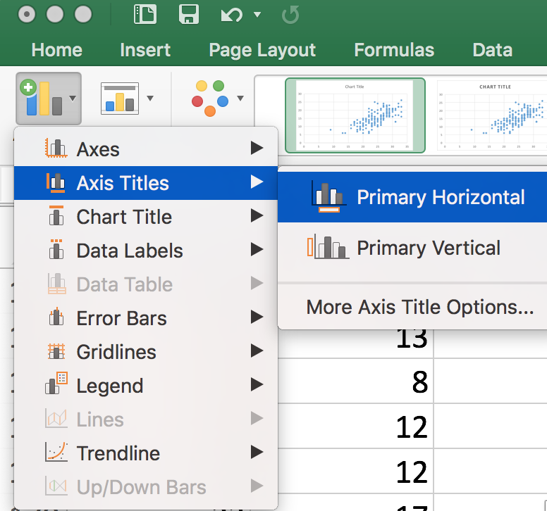
Creating a Scatterplot
Click on the Chart Title text box and replace Chart Title with Scatterplot
Click the Chart design tab to make it active. Click on the Add Chart Element icon and add appropriate axes titles.

Slide 6
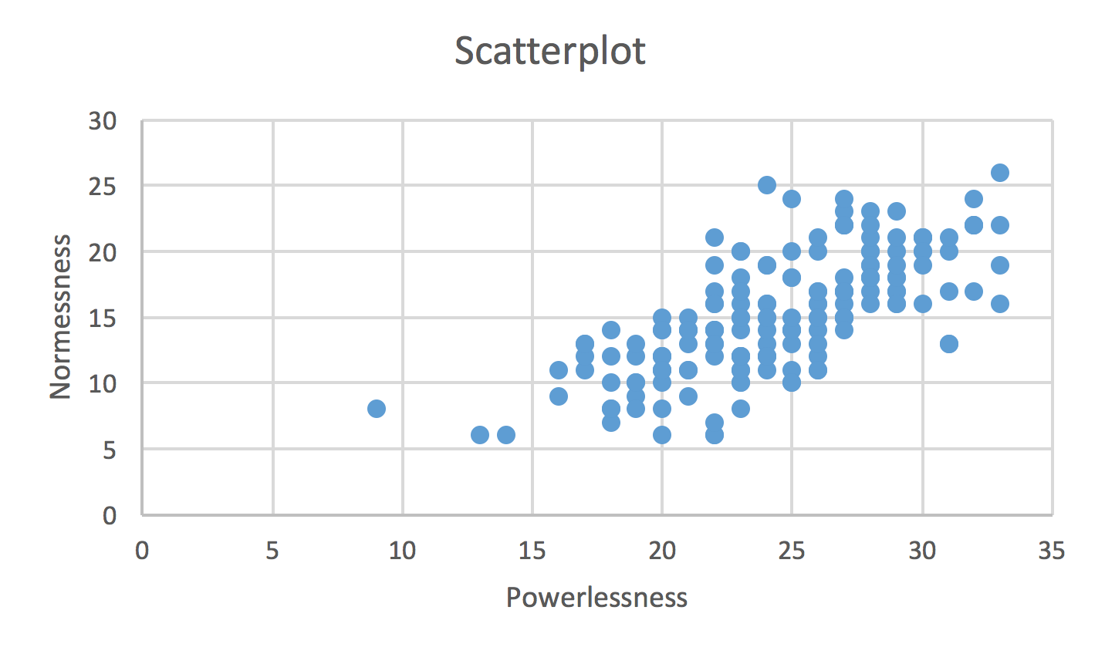
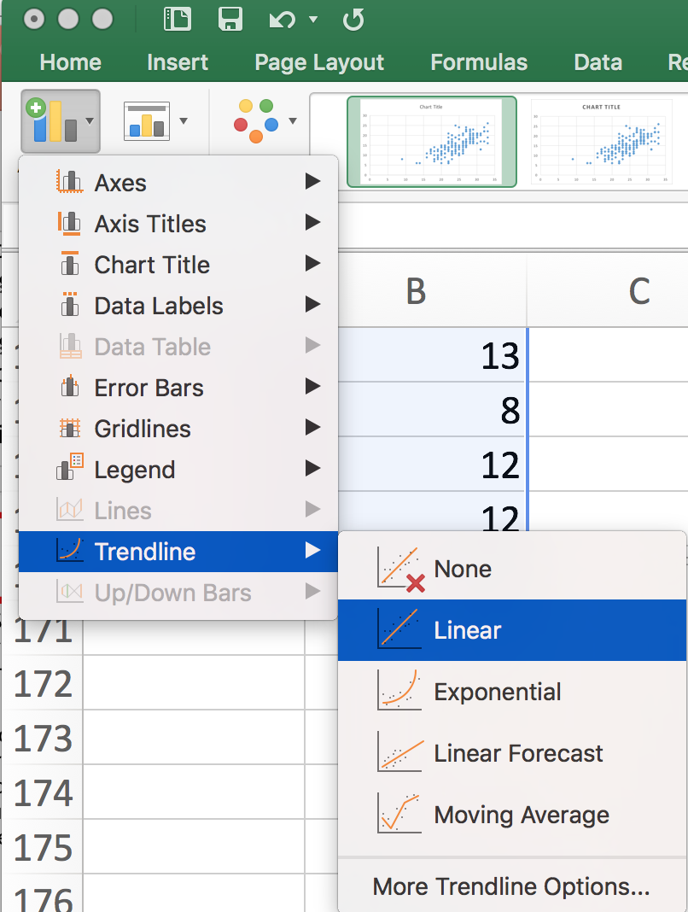
Creating a Scatterplot
Click the Chart design tab to make it active. Click on the Add Chart Element icon and add a linear trendline.

Slide 7
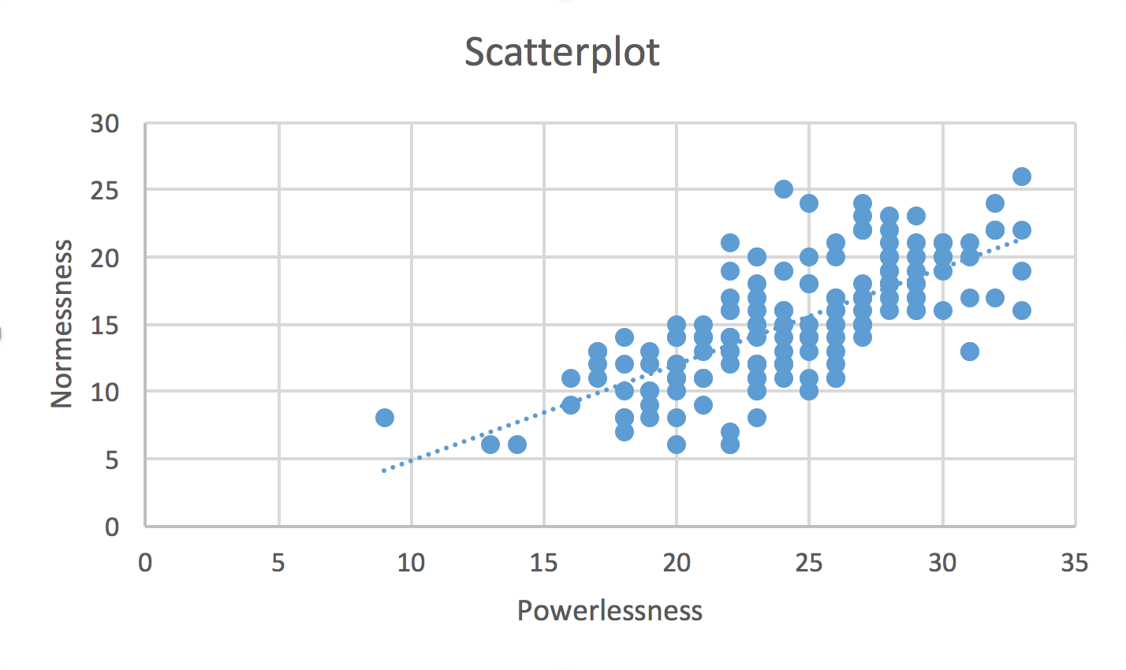
Creating a Scatterplot
The completed scatterplot with a linear trendline suggests that a linear relationship exists between powerlessness and normlessness since the amount of change between values on the two variables are close to constant along a linear (straight line) trend for the entire range of variable pairs. That is, the plot resembles a cigar-shaped band with no curves, suggesting linearity.
The direction of relationship is positive because the trendline has a positive slope (cases that score low on one variable also score low on the other variable and vice-versa).
Use the Pearson product-moment correlation (Pearson r) procedure to determine the strength of linear relationship.

Slide 8
Linearity & Scatterplots
End of Presentation

